Slide 1
APPEAL AND CLOTHING FLOWER BOUTIQUE
By akol rose
Located at Naguru go down bank village
Contact 0785357993or0757801008

Slide 3
Executive summary
my story is that my friend told me about WITU program and it was about business and I joined it for business ideation i learnt how to save and I started by saving small money and I started the business

Slide 4
Vision and mission
My vision is to be the leading fashion unique high quality and express your smartness
My mission is to work like slave and eat like aboss

Slide 5
Products and services offered

Slide 6
Target audience
I target both young girls and women interested in unique designs

Slide 7
Marketting tactics

Slide 8
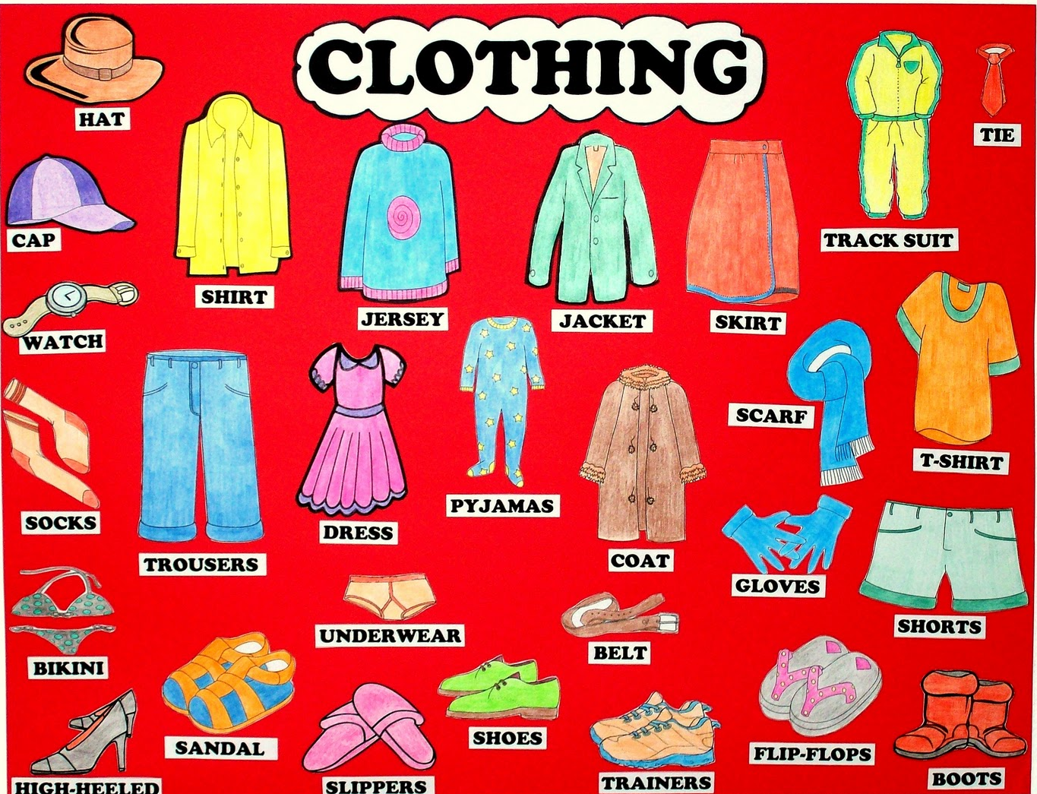
This Photo by Unknown Author is licensed under CC BY-SA-NC

Slide 9
Swot analysis
strength
weaknesses

Slide 10
budget
item | quatity | Unity price | amount
beil | 1 | 600000 | 600000
electricity | 3month | 60000 | 60000
rent | 3month | 600000 | 600000
transport | 1 month | 50000 | 50000
Packing bags | 1month | 10000 | 10000
lunch | 1 month | 20000 | 20000
branding |  | 20000 | 20000

